Slide 1

G H Raisoni College of Engineering & Management, Pune
(An Empowered Autonomous Institute Affiliated to Savitribai Phule Pune University)
Department of Information Technology
--------------------------------------------------------------------------------------------------------------------------------------------------
MicroAPI Guard: Real-Time API Anomaly Detection Using ML & DL
Review II
Presented by:
Sunny Nirmal [BTech ITC32]
Tausib Patel [BTech ITC37]
Yash Patil [BTech ITC54]
Guided by: Mrs.Priyanka kumbhar

Slide 2
Contents
Abstract
Introduction
Problem Statement
Objectives
Literature Survey
Existing System
System Block Diagram/ Architecture
Software and Hardware Requirements
System Implementation (60%)
Algorithms Used
Results Obtained
Conclusion
References

Slide 3
Abstract
This project proposes MicroAPI Guard, a deployable API security gateway designed to detect anomalous API traffic using a learned stacking ensemble model. Unlike traditional API gateways that rely only on rate limiting or signature-based detection, the proposed system performs three parallel stages of analysis:
Statistical Rate Limiter
Isolation Forest (Machine Learning)
Deep Autoencoder (Deep Learning)
The outputs of these detectors are combined using a Logistic Regression stacking ensemble to classify requests as Normal or Anomalous.
The system is implemented using FastAPI and Redis, enabling near real-time detection with minimal latency. A Streamlit dashboard provides live visualisation of alerts and model predictions, while a calibration phase re-derives the statistical baseline and decision threshold for a new backend without retraining the models from scratch.

Slide 4
Introduction
Modern applications are increasingly built using microservice architectures, where services communicate through REST APIs.
As the number of exposed APIs grows, the attack surface also increases, making APIs a major target for cyberattacks.
Traditional security mechanisms such as API Gateways, Web Application Firewalls (WAFs), and static rate-limiting rely on predefined rules and struggle to detect unknown or evolving threats.
Machine Learning techniques like Isolation Forest and Deep Learning models such as Autoencoders can identify abnormal API behavior by learning traffic patterns instead of depending on fixed signatures.
MicroAPI Guard is proposed as an intelligent API Security Gateway that combines Static Rules, Isolation Forest, Autoencoder, and a Logistic Regression stacking ensemble to perform real-time anomaly detection and automatically block malicious requests while forwarding legitimate traffic.

Slide 5
Problem Statement
The rapid adoption of microservice architectures has significantly increased the number of exposed REST APIs, expanding the application-layer attack surface. Traditional API security mechanisms, such as rule-based API Gateways and Web Application Firewalls (WAFs), rely on predefined static rules and struggle to detect modern application-layer attacks. An open and adaptive framework capable of learning API traffic behavior, detecting anomalies in real time, and automatically blocking malicious requests before they reach backend services is therefore required to provide effective API security.

Slide 6
Objectives
To develop a FastAPI-based real-time API protection gateway that intercepts HTTP requests and blocks malicious traffic with minimal latency.
To implement a learned stacking ensemble using Static Rules, Isolation Forest, Autoencoder, and Logistic Regression for accurate anomaly detection.
To establish a calibration mechanism that adapts the framework to different REST-based backends without retraining from scratch.
To evaluate the proposed system using standard performance metrics such as Precision, Recall, F1-Score, ROC-AUC, and PR-AUC.
To build a Streamlit dashboard for real-time monitoring and explainable visualization of anomaly detection results.

Slide 7
Literature Survey
Sr. No | Paper Name | Proposed Methodology/ Algorithm | Key Findings | Future Scope
1 | Huang et al. (2026) | API Gateway with EWMA & Z-score | Achieved 98.5% recall for DDoS detection. | Apply Deep Learning for unknown attack detection.
2 | Sowmya et al. (2023) | Random Forest + Bagging | Achieved 97.77% accuracy and 0.97 F1-score. | Extend IDS to IPS and support HTTP POST requests.
3 | Sadaf & Sultana (2020) | Autoencoder + Isolation Forest | Achieved 95.4% detection accuracy. | Validate on real-world cloud and fog traffic.

Slide 8
Sr. No | Paper Description | Proposed Methodology/ Algorithm | Key Findings | Future Scope
4 | Levi & Dubin (2025) | Automatic OpenAPI Mapping | High precision with low request processing time. | Improve payload inspection and support GraphQL/gRPC.
5 | Mahmoud et al. (2025) | Deep Stacking Ensemble | Improved detection accuracy with low false positives. | Develop lightweight models for edge deployment.

Slide 9
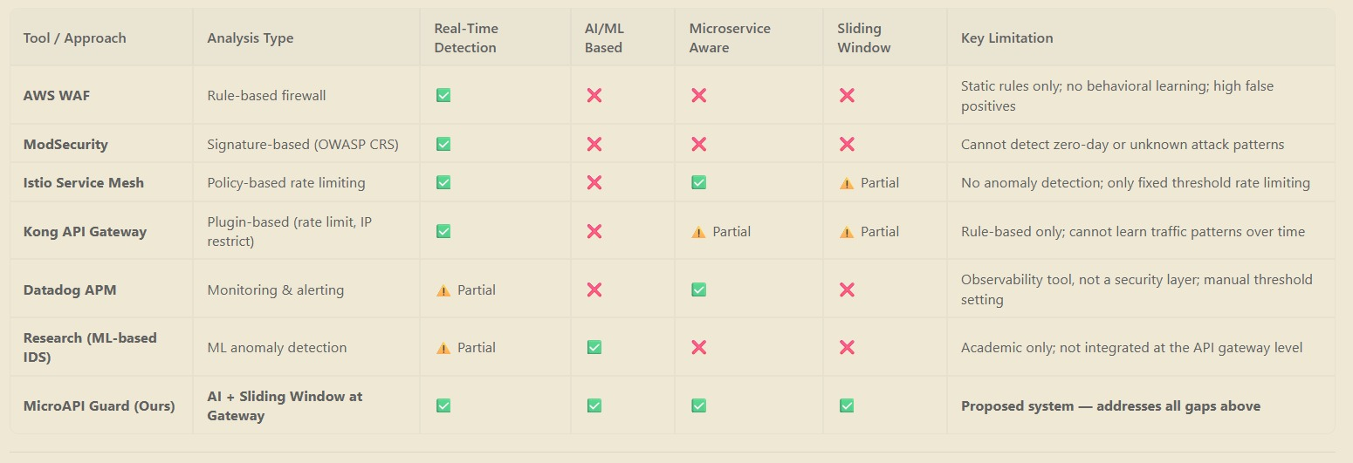
Existing System

Slide 10
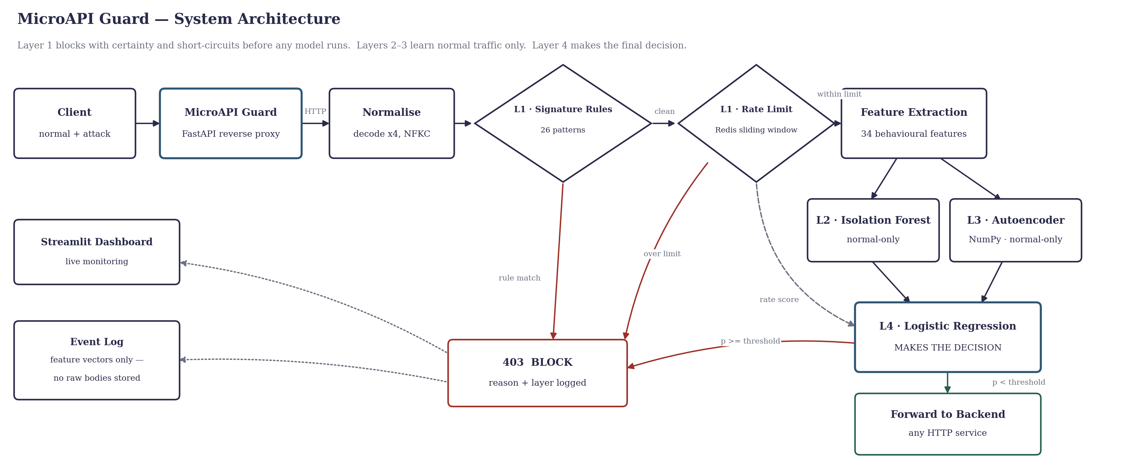
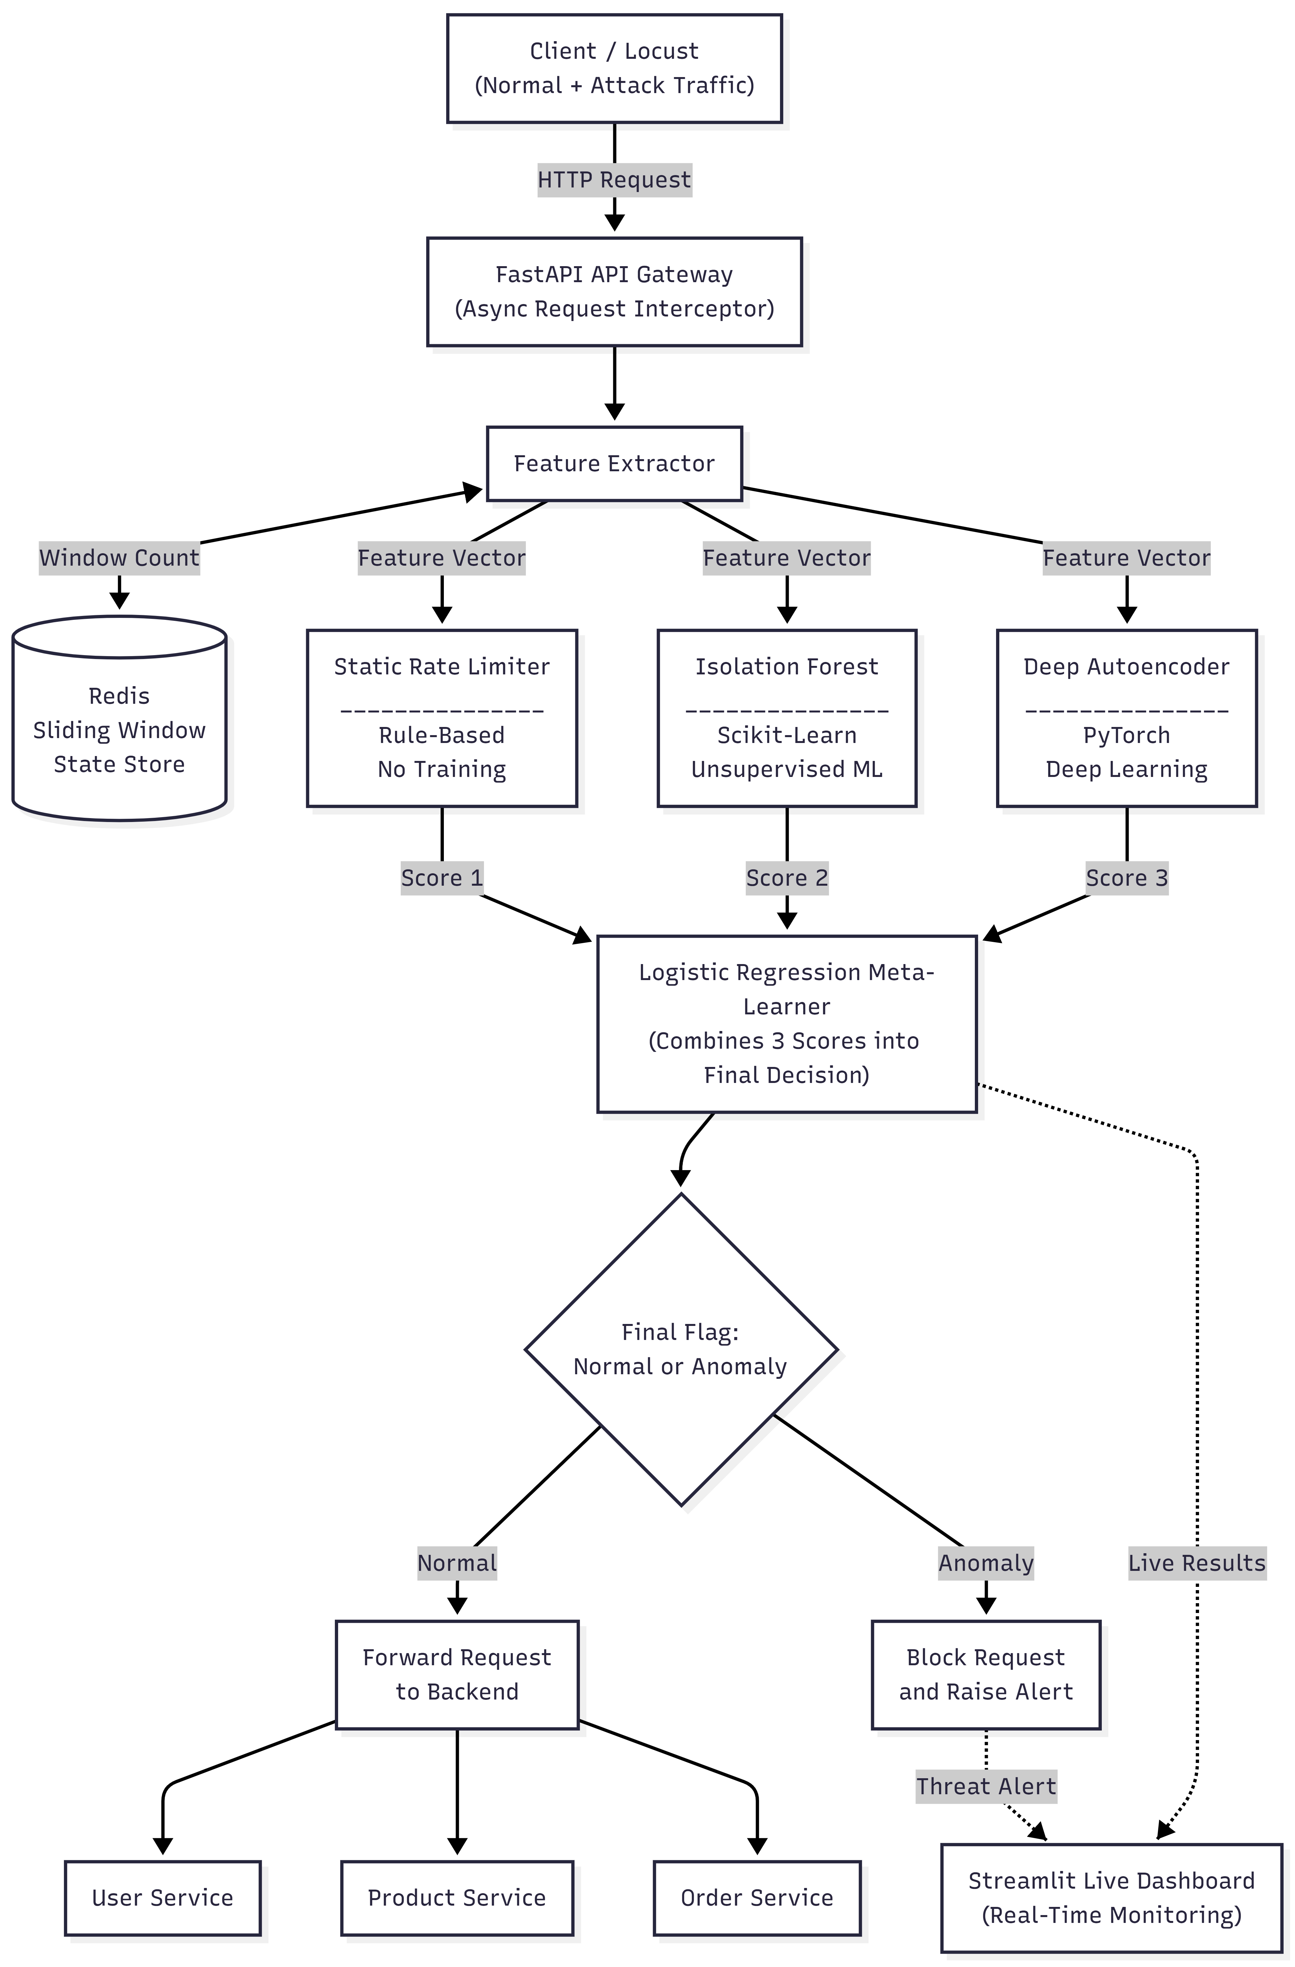
System Architecture
Figure : System Architecture

Slide 11
Software and Hardware Requirement
Software Requirements:
Software | Purpose
Python 3.10+ | Backend development & ML models
FastAPI | API Gateway & Microservices
Redis | Real-time feature extraction
Scikit-learn | Isolation Forest & Logistic Regression
NumPy | Autoencoder implementation (pure NumPy)
Python (stdlib) | API traffic generation & simulation
Streamlit | Monitoring Dashboard
Docker | Containerization

Slide 12
Hardware Requirements:
Hardware | Specification
Processor | Intel Core i5 / AMD Ryzen 5 or higher
RAM | 8 GB (Minimum)
Storage | 256 GB SSD
Operating System | Windows 10/11 or Linux
Internet | Stable Internet Connection

Slide 13
System Implementation
API Gateway (FastAPI + HTTPX): reverse proxy that inspects every request before it reaches the backend. Backend-agnostic — the protected service needs no code change.
Layer 1 — Static Security: 26 signature rules (SQL Injection, XSS, Path Traversal, Command Injection, SSRF) applied after multi-round decoding, plus Redis sliding-window rate limiting.
Layer 2 & 3 — Unsupervised Detectors: Isolation Forest and Deep Autoencoder trained on normal traffic only, using 34 behavioural features that carry no endpoint identity.
Layer 4 — Meta-Learner: Logistic Regression combines the three detector scores and makes the final Allow / Block decision.
Dataset: 35,496 labelled requests captured through the live gateway, covering normal traffic and 10 attack families.
Deployment & Monitoring: Docker Compose with only the gateway port exposed, Streamlit dashboard, and 92 automated tests.

Slide 14
Algorithms Used
Sliding-Window Rate Limiting: Redis sorted sets count each client's requests over 60 s and 5 s windows and pass a continuous rate score to the meta-learner.
Isolation Forest (300 trees): isolates rare points through random splits. Trained on normal traffic only, so it requires no attack labels.
Deep Autoencoder (34→32→12→32→34): trained with Adam and early stopping to reconstruct normal traffic. The reconstruction error becomes the anomaly score, which is what enables detection of unseen attacks.
Logistic Regression Meta-Learner: converts the three detector scores into a final anomaly probability. Its coefficients are readable, so the model can be verified.
Leakage-Free Training: sessions are split into four disjoint pools (base / meta / validation / test). The base detectors never see the data used to train or test the meta-learner, and the test pool is used only once.

Slide 15
Results of implementation
Learned stacking ensemble (34 features) evaluated on a held-out test set of unseen client sessions
Metric | Test set | 10 seeds (95% CI)
Accuracy | 0.9520 | —
Precision | 0.9611 | 0.978 [0.970 – 0.985]
Recall | 0.8989 | 0.764 [0.700 – 0.828]
F1-Score | 0.9290 | 0.854 [0.812 – 0.891]
ROC-AUC | 0.9926 | 0.987 [0.980 – 0.993]
PR-AUC | 0.9863 | 0.978 [0.968 – 0.986]
False Positive Rate | 0.0195 | 0.0099 [0.006 – 0.015]
False Negative Rate | 0.1011 | —
Zero-Day Recall | 0.8865 | 0.598 [0.445 – 0.749]
Confusion Matrix (test pool, n = 2,127)
 | Pred: Normal | Pred: Attack
Actual: Normal | 1358 | 27
Actual: Attack | 75 | 667
27 legitimate requests wrongly blocked (1.95%)
75 attacks missed (10.11%)
667 attacks correctly blocked
Layer 1 (deterministic): 31/31 attack patterns blocked, 0 false positives in 1,200 legitimate requests. Median detection latency 10.96 ms.
Baselines: rate-only F1 0.515, Isolation Forest 0.406, Autoencoder 0.870 — the ensemble beats all three, confirmed by McNemar's test (p < 0.001).

Slide 16
Conclusion
• MicroAPI Guard implements a four-layer API security gateway that blocks known attacks deterministically and flags unseen ones statistically.
• The deterministic layer is ready for use: 31 of 31 attack patterns blocked, with zero false positives across 1,200 legitimate requests.
• The stacking ensemble performs better than every individual detector, confirmed statistically using McNemar's test (p < 0.001).
• Zero-day capability was verified by withholding three attack families from training entirely, giving a mean recall of 0.598 (95% CI 0.445 – 0.749).
• All results are reported as means over 10 runs with confidence intervals rather than a single best run.
• Future work: retrain on real production traffic to enable full ML enforcement, and validate against a public benchmark such as CSIC 2010.

Slide 17
References
[1] H. Huang, Q. Qiang, Y. Shao, R. Li, and Y. Huang, "Design and Application Research of an Intelligent API Gateway for Traffic Anomaly Detection in Microservices Architecture," 2026 5th International Conference on Big Data, Information and Computer Network (BDICN), pp. 1–6, 2026.
[2] M. Sowmya, M. D. Irfan, A. J. Rai, P. B. Honnavalli, V. Spoorthi, and S. Nagasundari, "API Traffic Anomaly Detection in Microservice Architecture," 2023 IEEE/ACM 23rd International Symposium on Cluster, Cloud and Internet Computing Workshops (CCGridW), pp. 206–213, 2023.
[3] K. Sadaf and J. Sultana, "Intrusion Detection Based on Autoencoder and Isolation Forest in Fog Computing," IEEE Access, vol. 8, pp. 164917–164928, 2020.
[4] Y. Levi and R. Dubin, "API Security Based on Automatic OpenAPI Mapping," arXiv Preprint, 2025.
[5] L. Mahmoud, M. Liyanage, J. Singla, and S. Gangopadhyay, "DSEM-NIDS: Enhanced Network Intrusion Detection System Using Deep Stacking Ensemble Model," IEEE Open Journal of the Computer Society, 2025.

Slide 18
Thank You..

